Slide 1
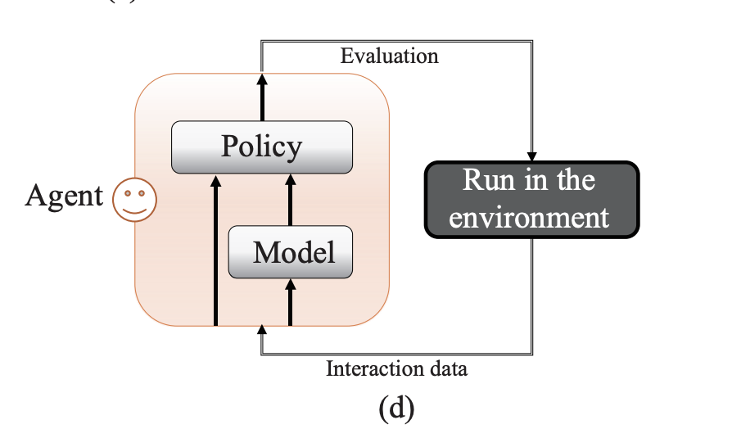
Foundational Model-based RL (MBRL)
Vanilla MBRL algorithm (only 1 feedforward NN)
Collecting data with current policy
Learn world model from past data
Improve policy by using world model
Embedding that retains observation of network
Robust MBRL (Model ensemble algorithm)
To avoid model bias, ensemble approaches were introduced
Collect samples and train ensemble of models
Collected “fictitious” samples from ensemble of models
Update policy using (for example) PPO on fictitious samples
Iterate until performance stops improving
Adaptive (Meta) MBRL
Learn ensemble of models that represent environment
Learn a policy that can quickly adapt to any of learned models
Better suited to adapt to the “real world” environment

Slide 2
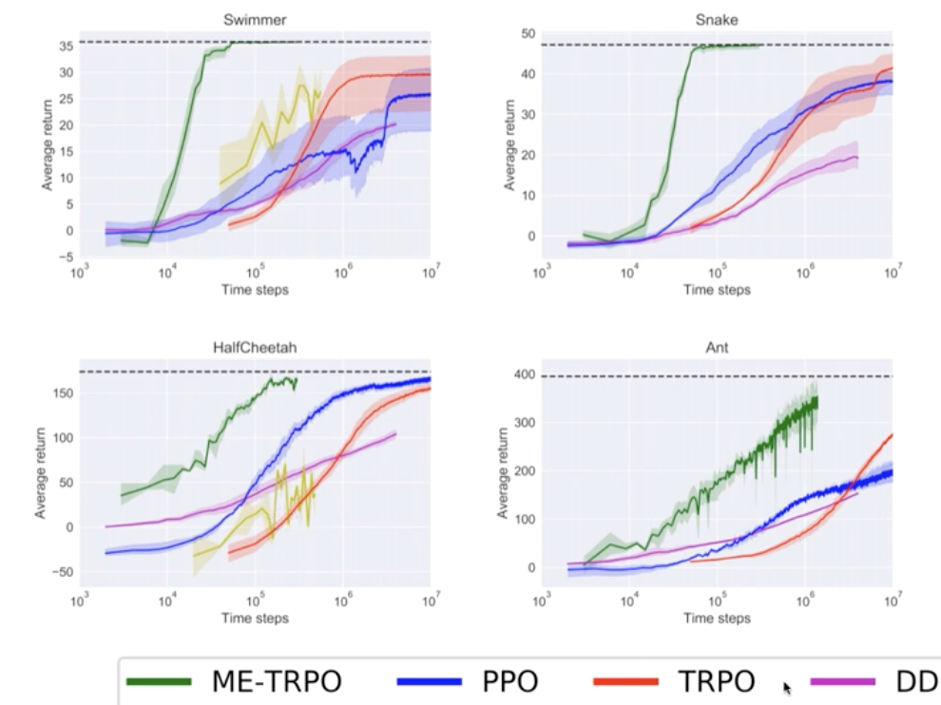
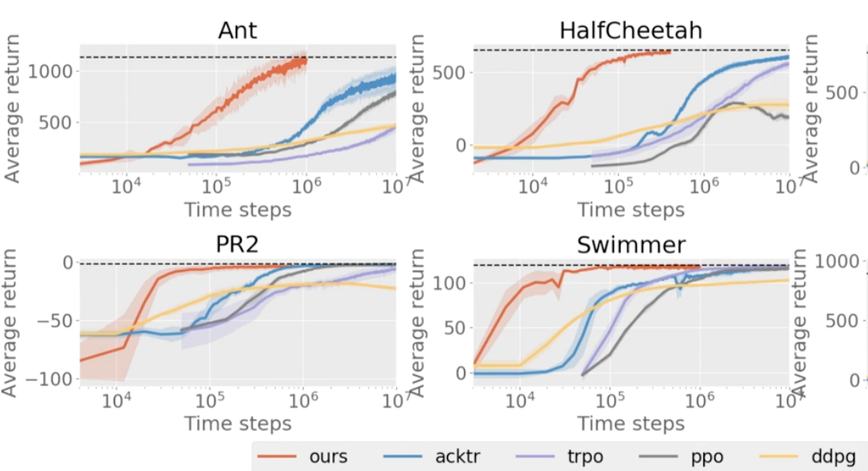
Practicality
Given an accurate world model, model-based RL can learn very quickly and be overwhelmingly sample-efficient compared to other RL approaches
Our observation vectors’ features are primarily categorical or binary and would be considered low-dimensional, which would be easier to model, quicker to train, and require fewer roll-outs than more complex environments
Orange line is MB-MPO, an adaptive meta MBRL approach, which learns much faster than PPO in RL envs
ME-TRPO, an ensemble MBRL approach, learns much faster than PPO in RL envs

Slide 3
Modeling the Network
Our environment has 8 nodes with 6 attributes and 7 possible actions
State representation: vector length of 48
Action representation: one-hot encoding in vector of length 7
Feedforward neural network architecture with:
Input: vector of state rep. concatenated with action rep. (length of 55)
Output: predicted next state vector
Collect data by interacting with environment with initial policy and train the model with collected state-action and next state-action pairs
Use the transition model with some MBRL approach, such as rollouts (1-5 steps)
Approaches can range from simple, single NN models (Dyna algorithm) to general state-of-the-art algorithms that perform well on a diverse set of tasks (Dreamer V3 – unnecessary for our use case)

Slide 4
Sim-to-real Gap Modelling
In robotics, this “gap” can refer to dynamics/sensor discrepancies present between simulation and real world envs. Agents are trained in simulation with these discrepancies in mind
Our case is less about physical rules and more about modeling network behavior –if our gymnasium environment fails to capture network dynamics, deployment following training will be infeasible
We can, however, use similar methods to lessen the dynamics in simulation and real network
examples:
Sim2Real RL – adjusting policies by incorporating real-world feedback
Meta-RL approaches which are effective at adapting to real environments
Ensemble reinforcement learning – multiple models or simulators that can generalize better

Slide 5
Next Steps (?)
MBRL seems like a practical first-step since our environment state isn’t overly complex – training with an effective model should be reasonably quick
simple, single modeled approaches to begin as they are easier to implement and test
Embedding – encoder and decoder in MBRL – look into capturing samples

